Slide 1




Market Intelligence & Investment Analysis
Real Estate Market Dashboard

Slide 2

Project Objective
Content:
Analyze real estate market behavior and investment opportunities
Identify high-demand and high-ROI neighborhoods
Support data-driven investment decisions through interactive dashboards

Slide 3

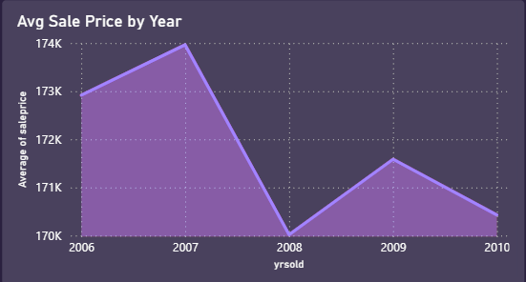
Market Price Trends (2006–2010)
Content:
Prices increased steadily until 2007, peaking at approximately $174K
Significant drop occurred in 2008 due to market instability
Partial recovery followed by slight decline in 2010
Market volatility highlights the importance of investment timing

Slide 4

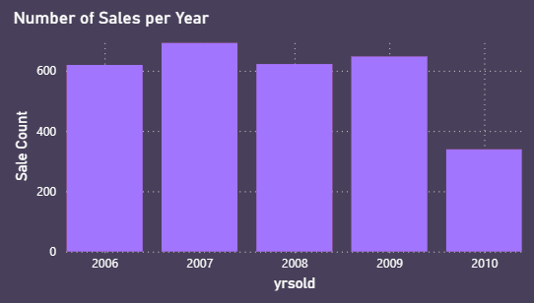
Sales Activity by Year
Content:
High transaction volume from 2006 to 2009 (~600 sales per year)
Sharp decline in 2010 (~350 sales), indicating reduced liquidity
Sales volume reflects changing market conditions

Slide 5

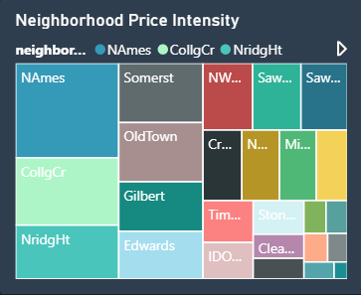
Neighborhood Sales Density
Content:
NAmes and CollgCr show the highest sales activity
NridgHt maintains stable demand with moderate activity
High-demand areas present lower liquidity risk
12K+
3K+

Slide 6
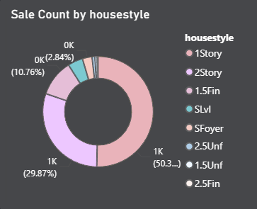
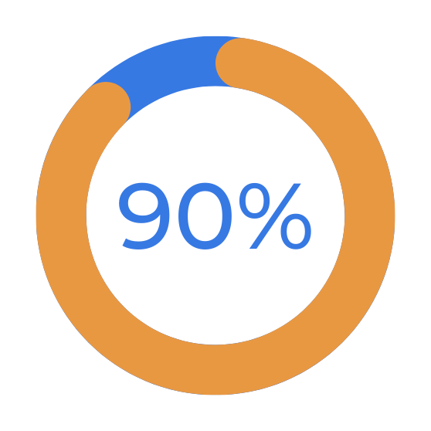
Housing Type Preferences
Content:
1Story homes account for nearly 50% of total sales
2Story homes represent around 30%
Other housing types have limited demand
Focus on dominant housing types improves resale potential

Slide 7
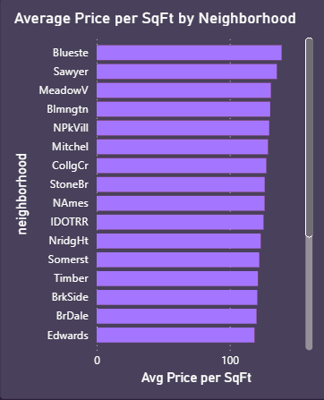
Price Variation Across Neighborhoods
Content:
Significant price differences exist between neighborhoods
Blueste leads the market as a premium area
NAmes offers balanced pricing with high demand
Edwards provides lower entry costs but weaker demand
Strategy 01
Strategy 02
Strategy 03

Slide 8
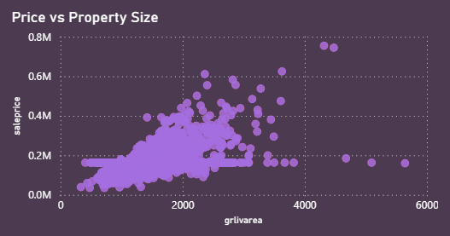
Property Size vs Sale Price
Content:
Strong positive relationship between size and price
Premium pricing observed in select mid-sized properties
Location and quality strongly influence valuation

Slide 9
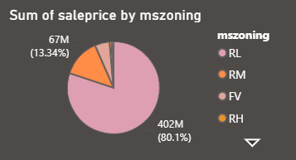

Zoning Impact on Market Value
60K
Content:
RL zoning dominates total sales value (~$402M)
RM zoning follows with moderate market share
Investors prefer low-density residential zones

Slide 10
Key Insights
Market demand and ROI are highly location-dependent
High-activity neighborhoods offer safer investments
Premium areas deliver higher returns with higher capital
Dashboard enables informed, data-driven investment decisions

Slide 11
THANK YOU

